Slide 1
Introduction to Machine Learning
Session 2
For TUM PhD students
Claudia Serrano Colome
claudiaserranocolome@gmail.com

Slide 2
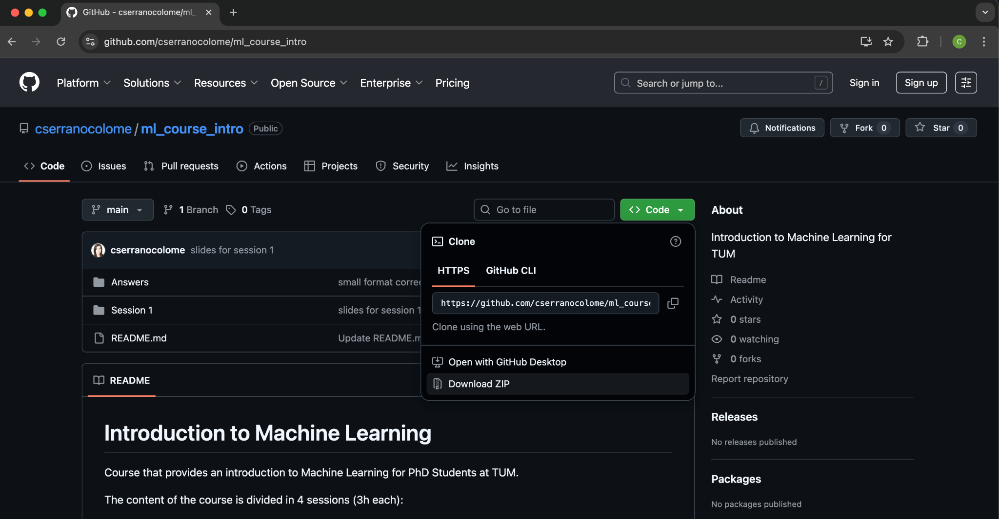
Github
Navigate to https://github.com/cserranocolome/ml_course_intro
Download the materials for the session

Slide 3

Anaconda Navigator
Start Anaconda Navigator and click on Launch under the jupyter notebook tool

Slide 4
Recap from last session
What is Machine Learning (ML)? And why ML?
Types of ML
ML Workflow
Data handling and preprocessing
Handling missing values
Encoding categorical variables
Feature scaling & normalization
Splitting data into training/test sets

Slide 5
Today's session outlook
Supervised Learning concepts
Regression algorithms
Linear Regression
Multiple Linear Regression
Beyond Linear Regression
Common pitfalls
The Learning Process - Loss function
Classification algorithms
Logistic Regression
k-Nearest Neighbors
Decision Trees
Random Forest

Slide 6
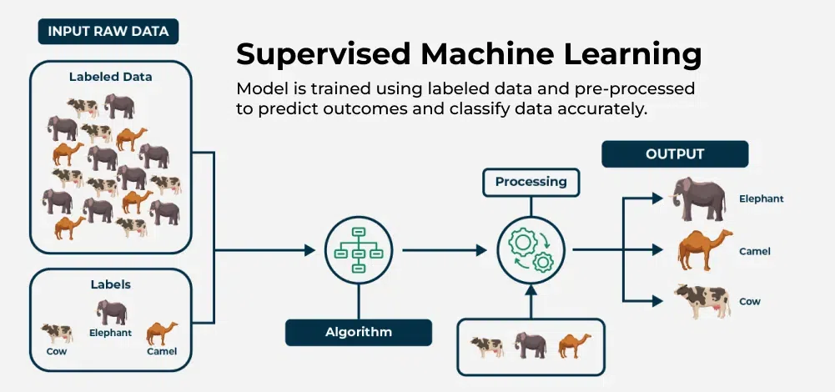
What is Supervised Learning?
Source: https://www.geeksforgeeks.org/machine-learning/supervised-machine-learning/
Learning from labeled data
Notes:
Analogy: Teacher provides the correct answers during training

Slide 7
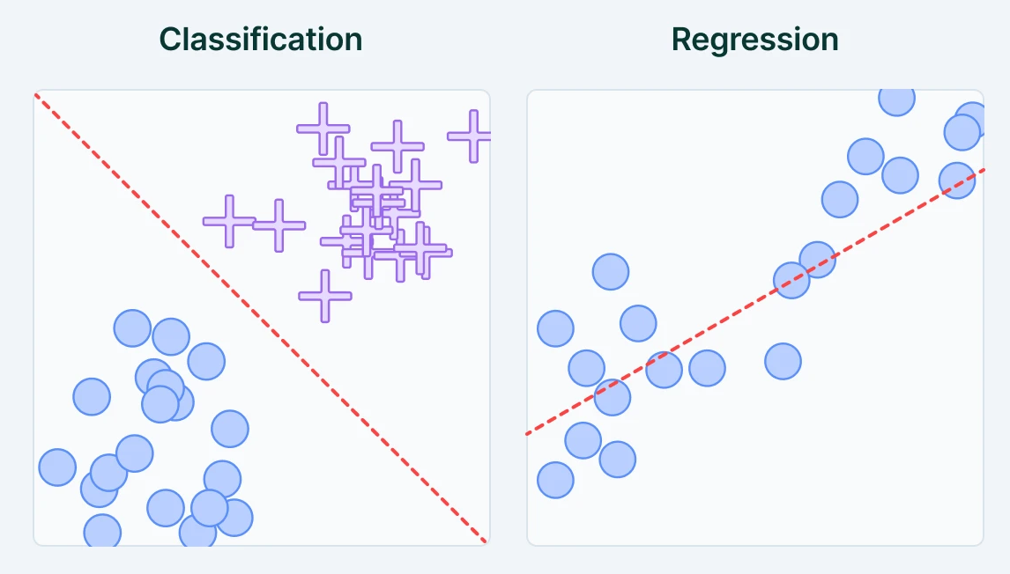

Classification vs Regression
Classification: discrete output (classes)
Regression: continuous output (numbers)
Source: https://www.springboard.com/blog/data-science/regression-vs-classification/

Slide 8
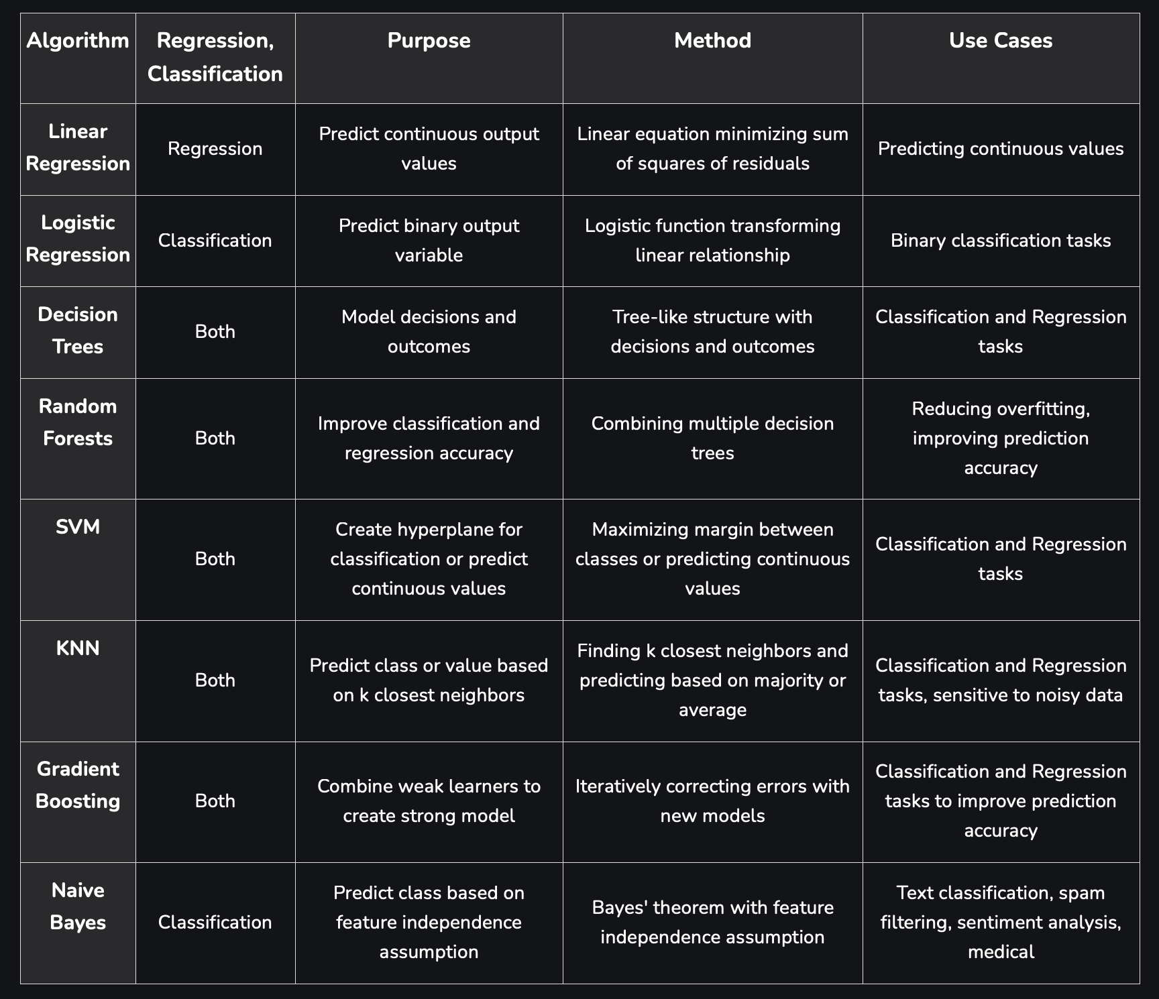
Examples

Slide 9
Introduction to Regression
Predict continuous outcomes
Examples: house prices, stock returns, growth rates
It has a swimming pool
Price of the house
Very far away of the centre of the city
Size of the house

Slide 10
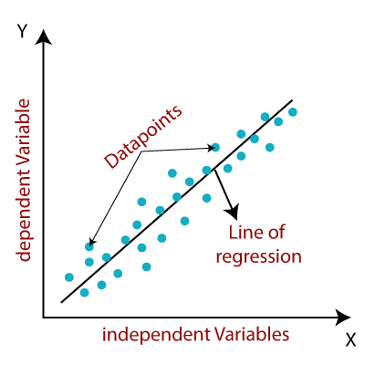
Linear Regression
Fit a straight line to minimize squared error.
Equation: y = P₀ + P₁x₁
In this case, “fitting” means estimating the value of P₀ and P₁

Slide 11
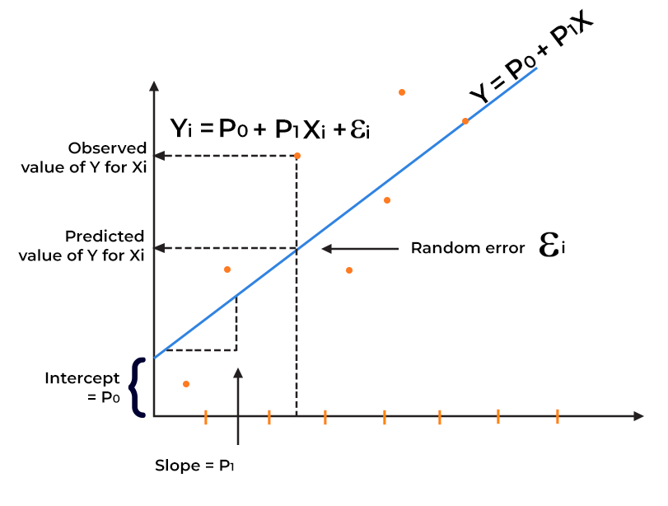
Linear Regression
Residual Sum of Squares
RSS = ∑_{n} (y_{n}obs - y_{n}pred)²

Slide 12
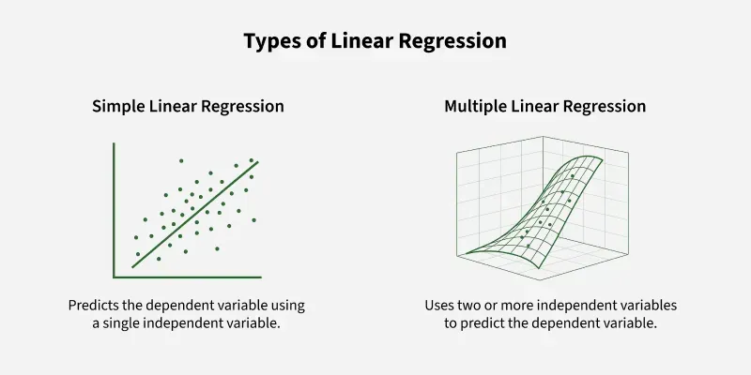
Multiple Linear Regression
Equation: y = P₀ + P₁x₁ + P₂x₂ + … + P_{n}x_{n}
It has a swimming pool
Price of the house
Very far away of the centre of the city
We might want to add
Distance to the city center
Number of swimming pools
as variables of the model.
Size of the house

Slide 13
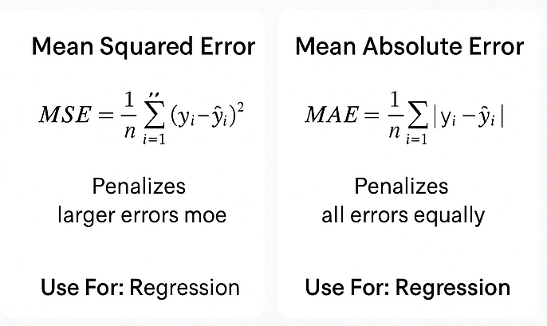
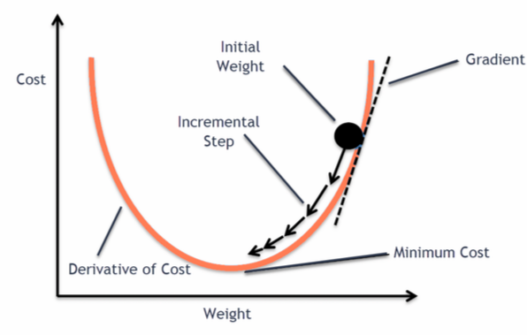
The Learning Process - Loss function
In ML, a loss function is used to measure model performance by calculating the deviation of a model’s predictions from the correct “ground truth” values.
Gradient descent is often used to find parameters that minimize the loss.
Training means adjusting parameters to minimize loss.

Slide 14
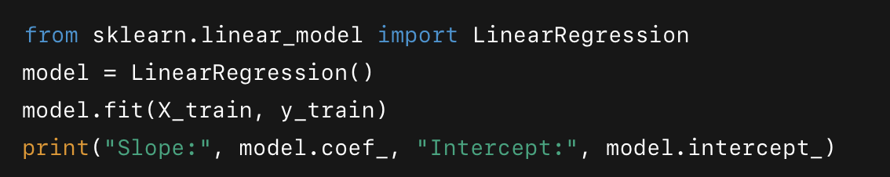
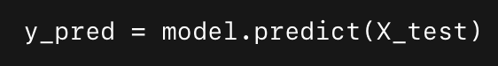
Multiple Linear Regression
Equation: y = P₀ + P₁x₁ + P₂x₂ + … + P_{n}x_{n}
It has a swimming pool
Price of the house
Very far away of the centre of the city
Size of the house

Slide 15
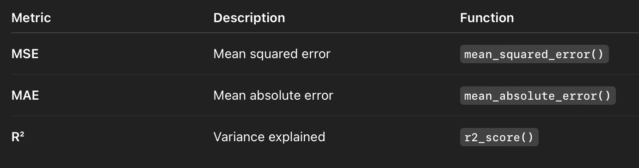
Evaluation metrics
It is better when:
Even though it is called R^2 it can still be negative if it is worse than random.
More about it in Session 4.

Slide 16
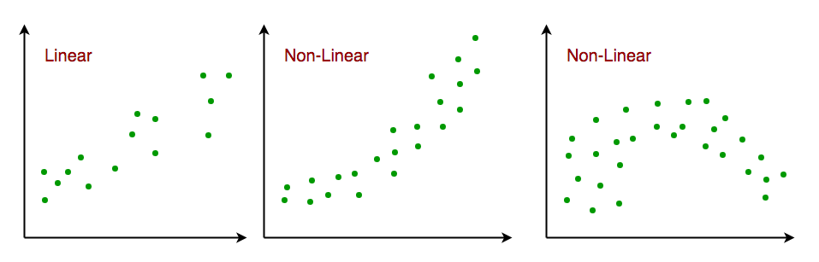

Beyond Linear Regression
Polynomial regression (non-linear relationships)
Equation: y = P₀ + P₁x₁ + P₂x₁²
Now P₀ , P₁ and P₂ are the parameters
Regularization (ridge, lasso) to avoid overfitting
Adding a penalty term to the objective function
RSS + ∑_{k} |P_{k}|

Slide 17


Ridge - Lasso - Elastic Net
Different regularization strategies
Features | Lasso Regression | Ridge Regression | Elastic Net Regression
Penalty Type | L1 Penalty: Lasso uses the absolute values of coefficients. | L2 Penalty: Ridge uses the square of the coefficients. | L1 + L2 Penalty: Elastic Net uses both absolute and square penalties together.
Effect on Coefficients | It completely removes unnecessary features by setting their coefficients to zero. | It makes all coefficients smaller but doesn’t set them to zero. | It removes some features and reduces others by balancing both.

Slide 18
Hyperparameter Tuning
Hyperparameter tuning is the process of selecting the optimal settings, or hyperparameters, for a machine learning model before training begins to maximize its performance.
They are not parameters of the model itself, but terms in the loss or in the structure of the model.
Examples:
Lambda terms in the loss of ElasticNet regression.
Number of trees in random forest model.

Slide 19
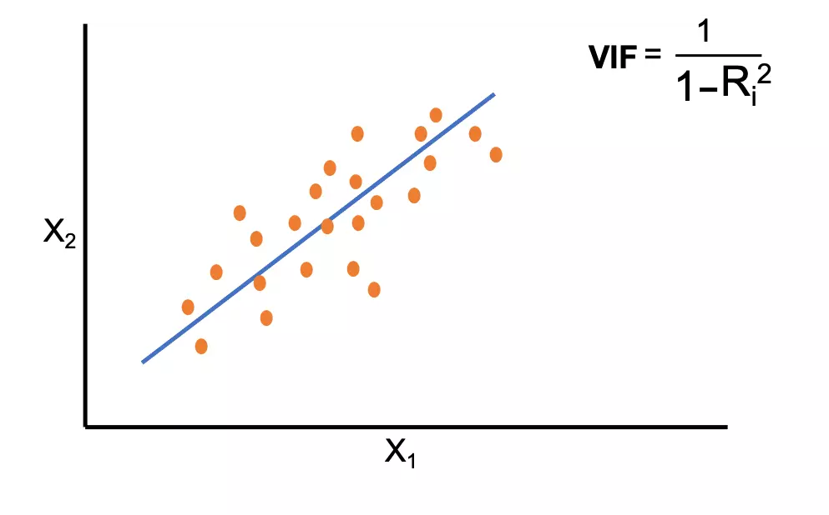
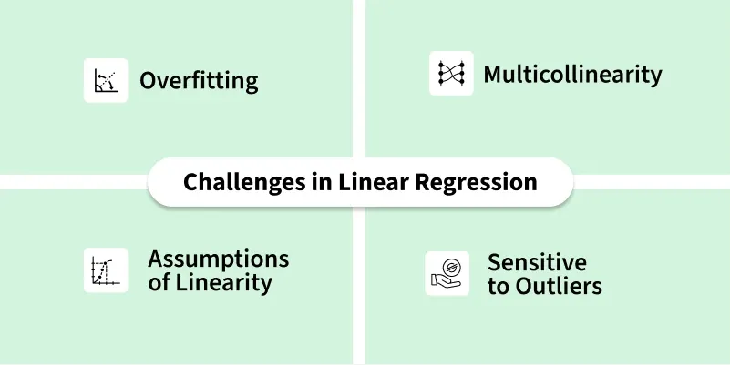
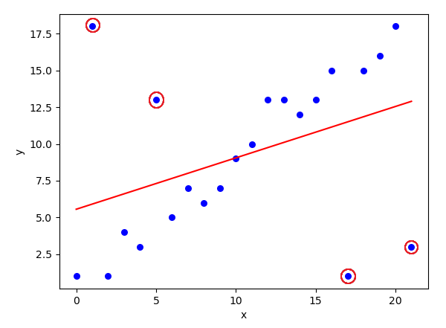
Regression Pitfalls

Slide 20
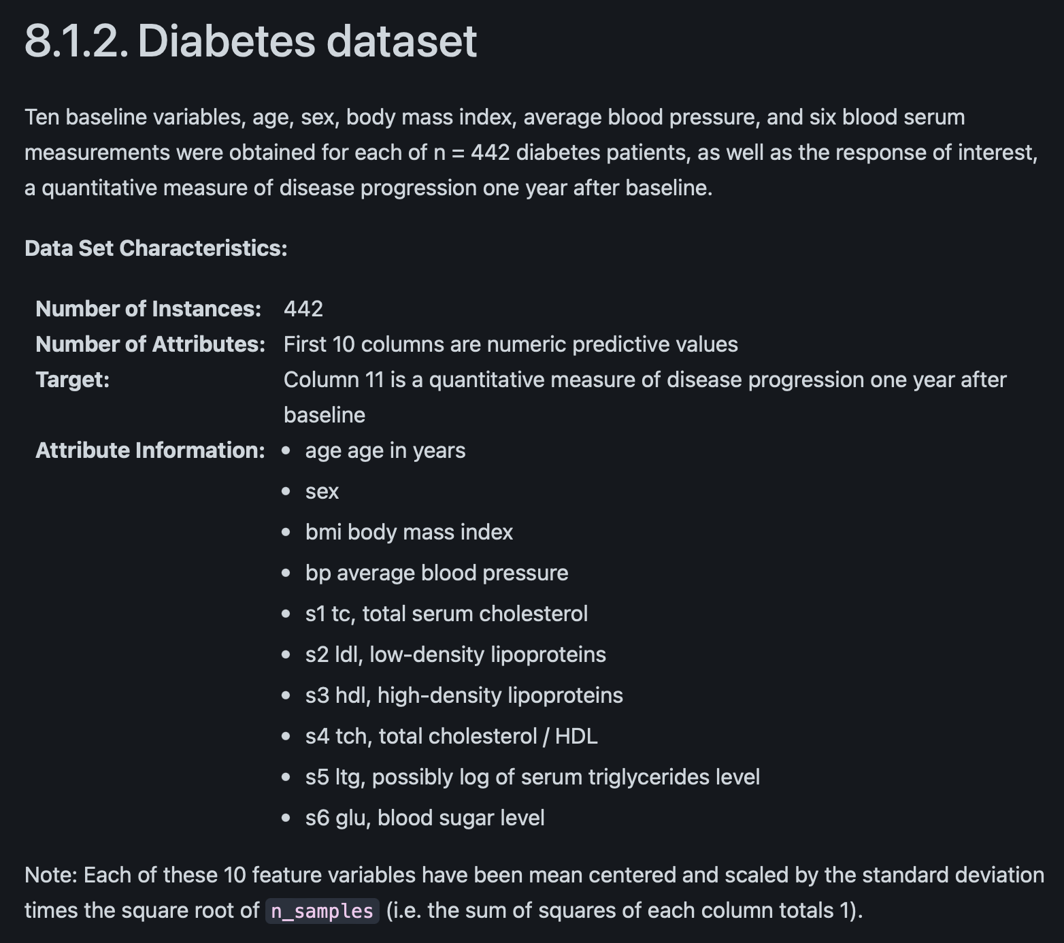

Diabetes Dataset
https://scikit-learn.org/stable/datasets/toy_dataset.html

Slide 21
Hands On

Slide 22
Break

Slide 23
Introduction to Classification
Goal: assign input to one of several categories
Typical datasets: Iris flowers, handwritten digits, tumor diagnosis
From lines to boundaries:

Slide 24
Common Algorithms for Classification
Logistic Regression
k-Nearest Neighbors (kNN)
Decision Trees
Random Forests
SVMs

Slide 25
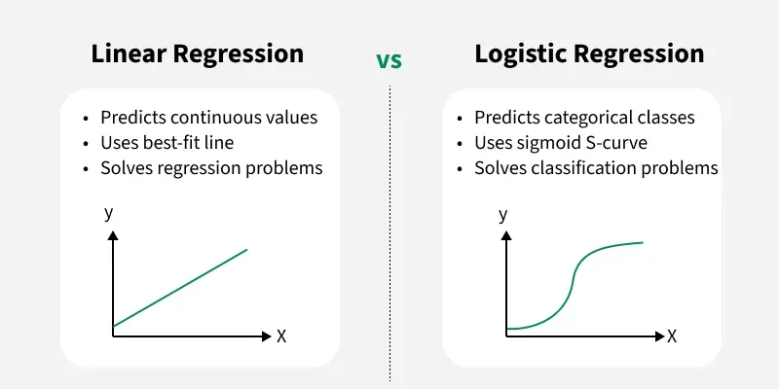
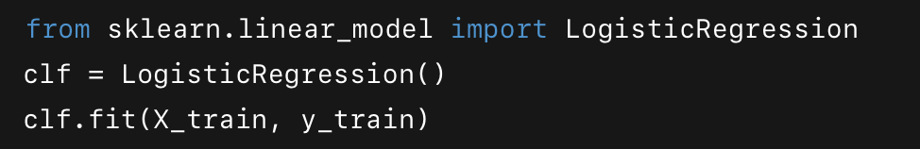
Logistic Regression
Sigmoid function maps values to [0,1]
Threshold at 0.5 → classification
Example: probability of disease given patient data

Slide 26
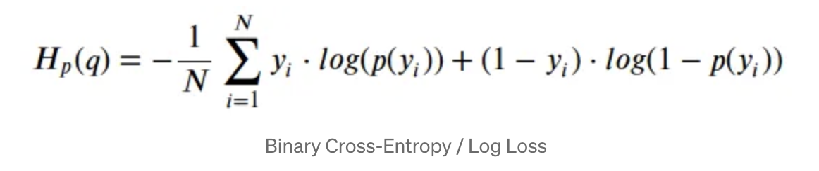
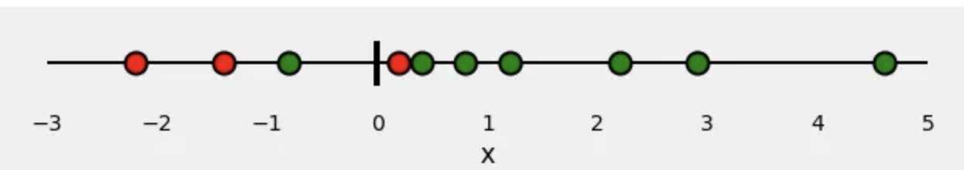
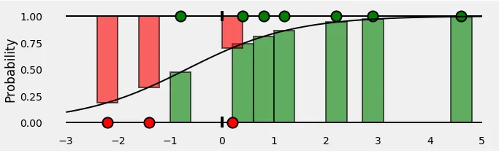
The Learning Process - Loss function
Intuition: punishes confident but wrong predictions
Labels:
Green points are 1 (positive class)
Red points are 0 (negative class)
Fit a probability distribution that attributes high values to green points and low values to red ones

Slide 27
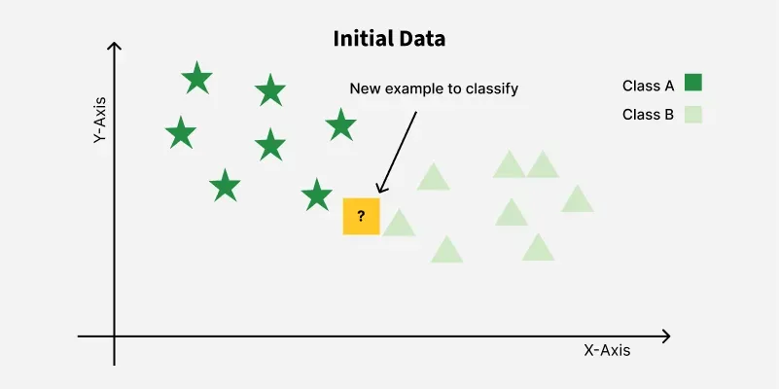
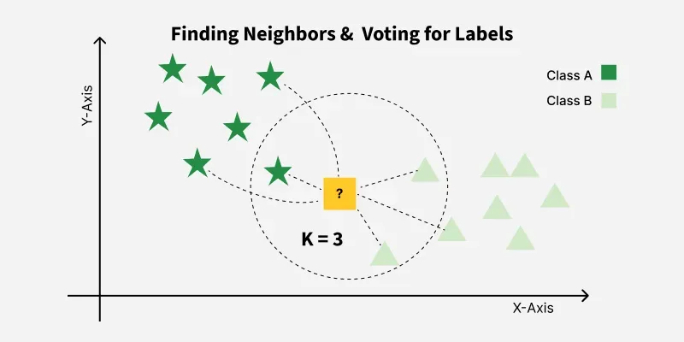
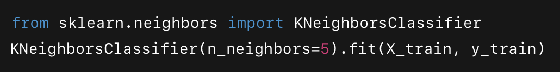
k-Nearest Neighbors (kNN)
Classify based on majority vote of k closest points

Slide 28
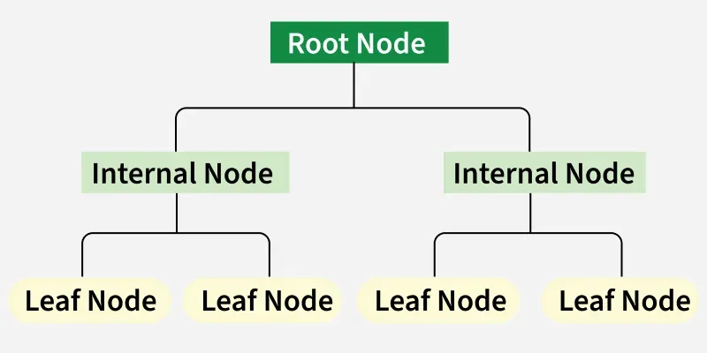

Decision Trees
Rule-based splitting of data
Easy to interpret, visualize
Overfitting if too deep

Slide 29
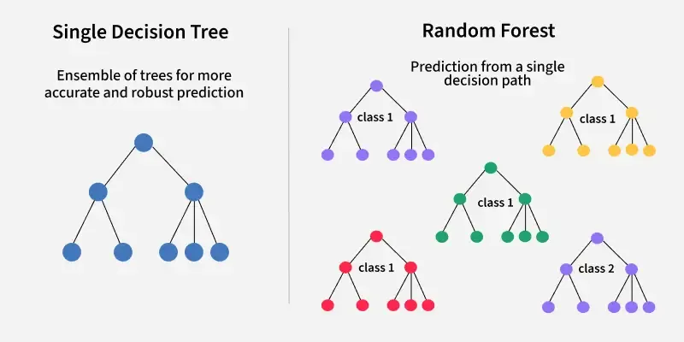
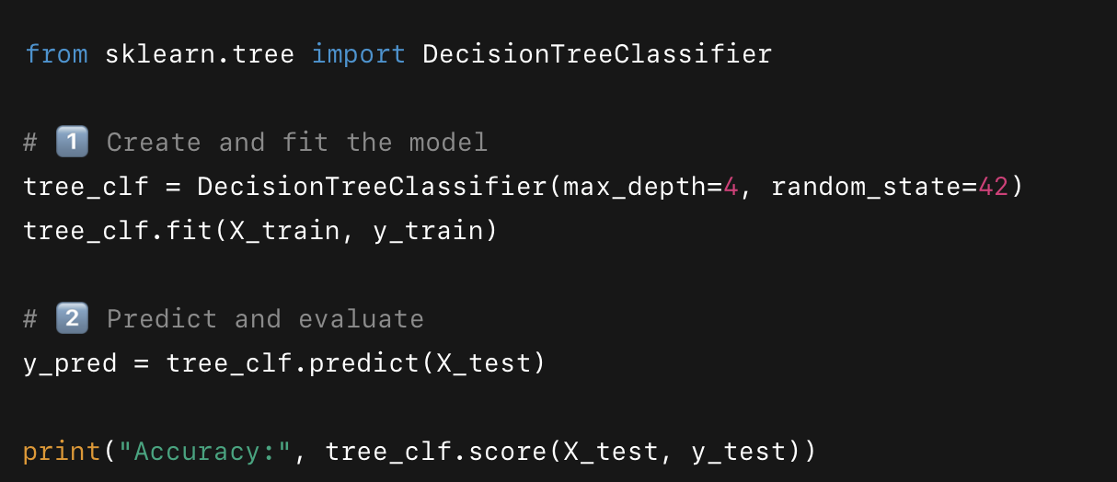
Random Forest
Random Forest = an ensemble of Decision Trees trained on random subsets of data and features. Reduces variance and overfitting.
Swap the command for RandomForestClassifier

Slide 30
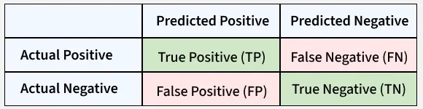
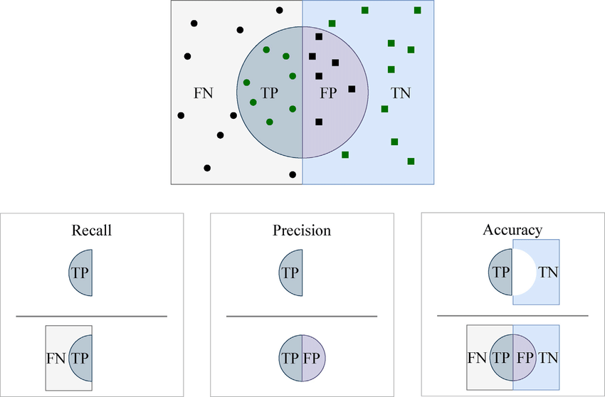
Confusion Matrix for Evaluation

Slide 31
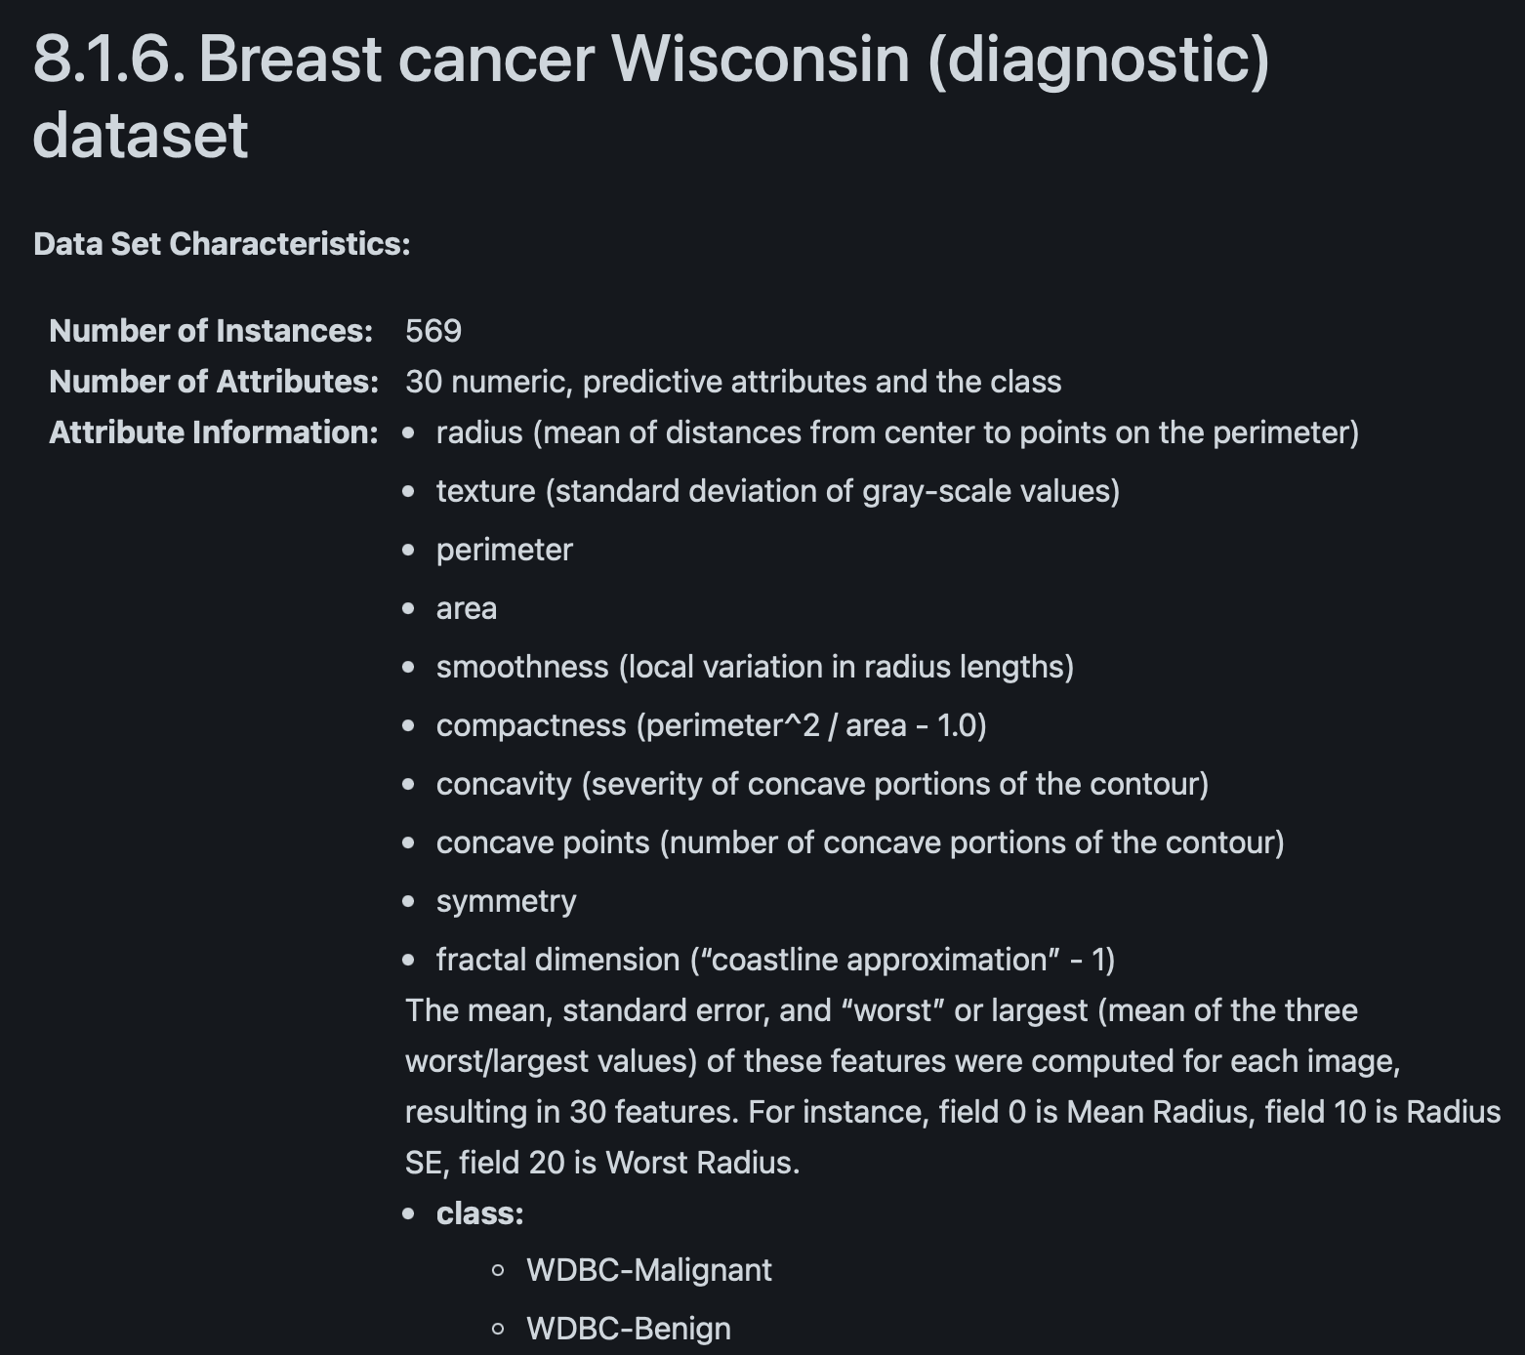
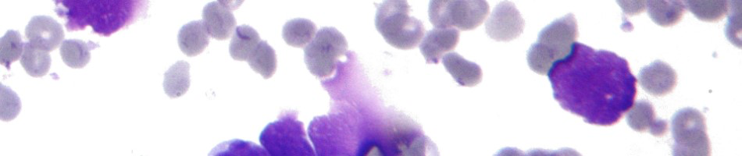
Breast Cancer Dataset
https://scikit-learn.org/stable/datasets/toy_dataset.html

Slide 32
Hands On

Slide 33
Additional resources
Supervised learning
https://www.geeksforgeeks.org/machine-learning/supervised-machine-learning/
Regression vs Classification and different algorithms
https://www.springboard.com/blog/data-science/regression-vs-classification/
Regularized Linear Regression
https://medium.com/@novus_afk/regularized-linear-regression-35d5eaaa84d5 https://www.geeksforgeeks.org/machine-learning/lasso-vs-ridge-vs-elastic-net-ml/
Loss functions in ML
https://www.datacamp.com/tutorial/loss-function-in-machine-learning
https://www.geeksforgeeks.org/machine-learning/ml-common-loss-functions/
Hyperparameter tuning
https://www.geeksforgeeks.org/machine-learning/hyperparameter-tuning/

